Slide 1
Regression Analysis
Poisson Regression
Nicoleta Serban, Ph.D.
Professor
Stewart School of Industrial and Systems Engineering
Goodness of Fit Assessment

Slide 2

About This Lesson

Slide 3
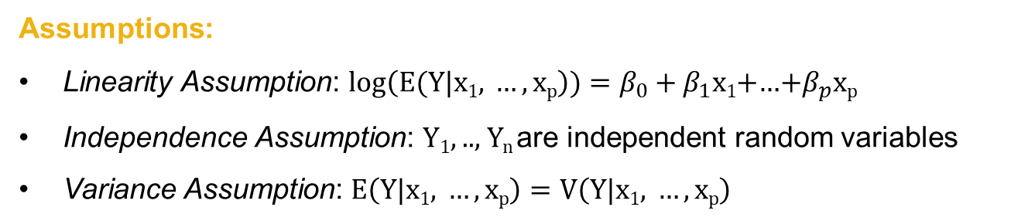
Poisson Regression Model
Data: {(x₁₁,.., x_{1p}),Y₁},….,{(x_{n1},.., x_{np} ),Y_{n}} where Y₁, .., Y_{n} are event count data per observation unit with a Poisson distribution
Assumptions:
Linearity Assumption: $log\left(E(Y|\text{x}\text{1}\text{, }…,\text{x}\text{p}\right))=β_{0}+β_{1}\text{x}\text{1}$+…+$β_{p}\text{x}\text{p}$
Independence Assumption: Y₁, .., Y_{n} are independent random variables
Variance Assumption: $E\left(Y|\text{x}\text{1}\text{, }…,\text{x}\text{p}\right)=V\left(Y|\text{x}\text{1}\text{, }…,\text{x}\text{p}\right)$
There is no error term! How to check the assumptions?

Slide 4
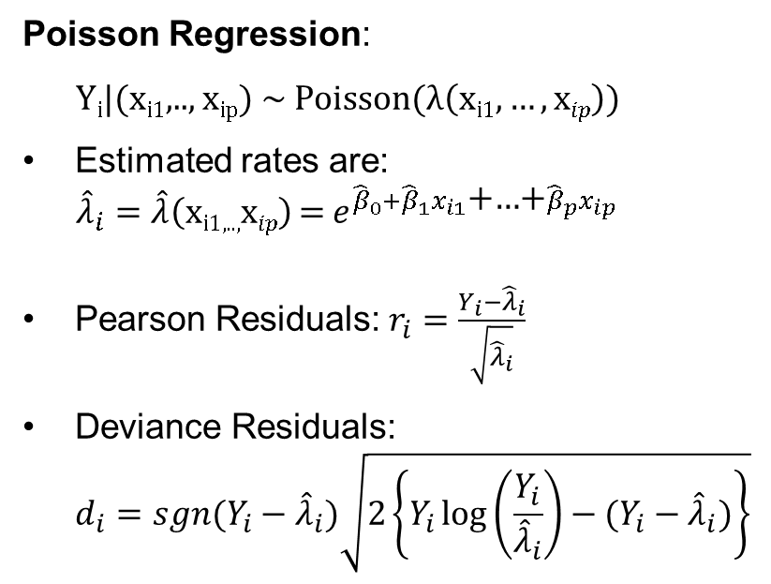
Residuals in Poisson Regression
Poisson Regression:
Y_{i}|(x_{i1},.., x_{ip}) ~ Poisson(λ$\left(\text{x}\text{i}\text{1},…,\text{x}ip\right)$)
Estimated rates are:
$${\hat{λ}}_{i}=\hat{λ}\left(\text{x}\text{i}\text{1,..,}\text{x}ip\right) \text{=}{{ e}^{{\hat{β}}_{0}+{\hat{β}}_{1}x_{i1}\text{+…+}{\hat{β}}_{p}x_{ip}}}^{ }$$
Pearson Residuals: $r_{i}=\frac{Y_{i}−{\hat{λ}}_{i}}{\sqrt{{\hat{λ}}_{i}}}$
Deviance Residuals:
$d_{i}=sgn(Y_{i}−{\hat{λ}}_{i})\sqrt{2\left\{Y_{i}\log\left(\frac{Y_{i}}{{\hat{λ}}_{i}}\right)−(Y_{i}−{\hat{λ}}_{i})\right\}}$
Pearson’s residuals follow directly a normal approximation to a binomial. Hence approximately N(0,1)
The deviance residuals are the signed square root of the log-likelihood evaluated at the saturated model vs. the fitted model. Thus approximately N(0,1) if the model is a good fit.
Deviances play the role of sum of squares in a linear model.

Slide 5
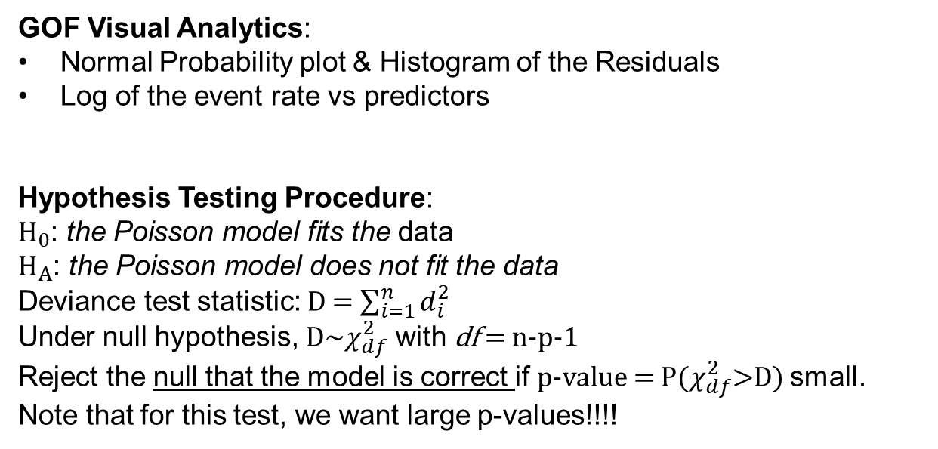
Goodness of Fit
GOF Visual Analytics:
Normal Probability plot & Histogram of the Residuals
Log of the event rate vs predictors
Hypothesis Testing Procedure:
${\text{H}}_{0}$: the Poisson model fits the data
${\text{H}}_{A}$: the Poisson model does not fit the data
Deviance test statistic: D = $\sum_{i=1}^{n}{d_{i}^{2}}$
Under null hypothesis, D~$χ_{df}^{2}$ with df = n-p-1
Reject the null that the model is correct if p-value = P($χ_{df}^{2}$>D) small. Note that for this test, we want large p-values!!!!

Slide 6
What if No Goodness of Fit?
Add predicting variables, consider interaction terms, or/and transform predicting variables to improve linearity;
Identify unusual observations (outliers, leverage points);
The Poisson distribution isn’t appropriate:
  Overdispersion: the variability of the estimated rates is larger than would be implied by a Poisson model
    Correlation in the observed responses
    Heterogeneity in the rates that hasn’t been modeled

Slide 7
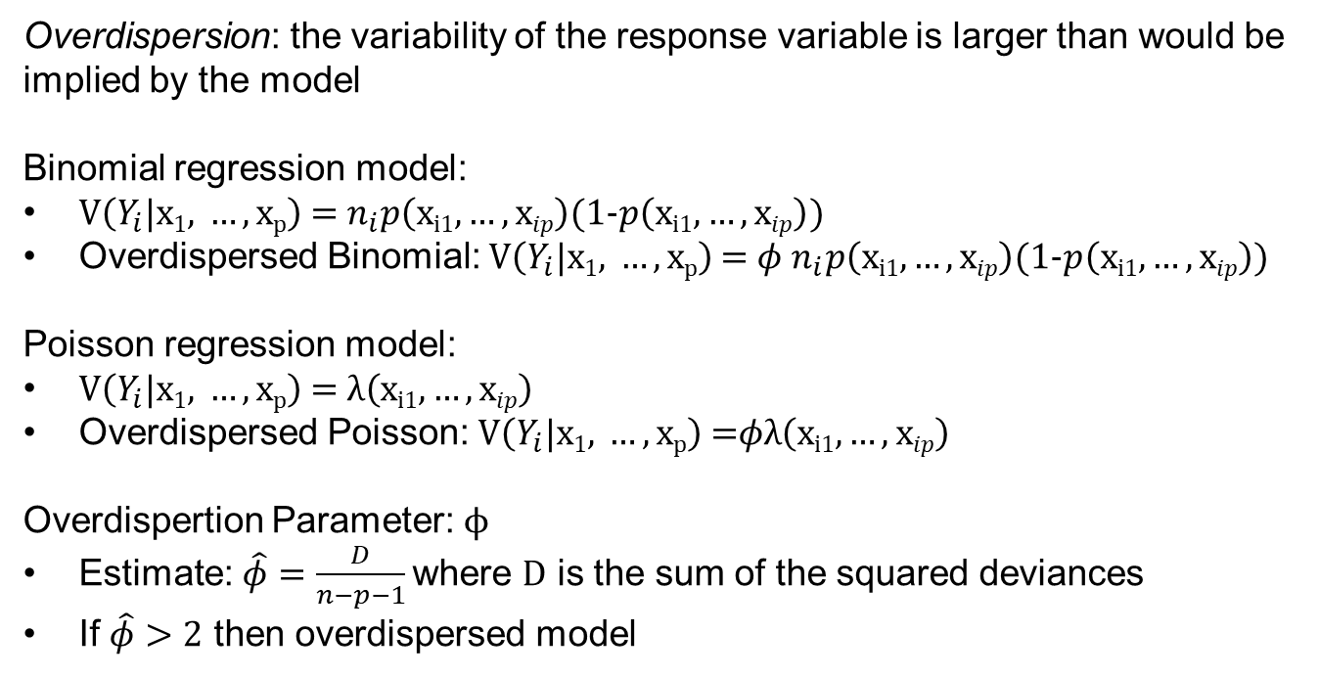
Overdispersion
Overdispersion: the variability of the response variable is larger than would be implied by the model
Binomial regression model:
$V\left(Y_{i}|\text{x}\text{1}\text{, }…,\text{x}\text{p}\right)$ = $n_{i}p\left(\text{x}\text{i}\text{1},…,\text{x}ip\right)$(1-$p\left(\text{x}\text{i}\text{1},…,\text{x}ip\right)$)
Overdispersed Binomial: $V\left(Y_{i}|\text{x}\text{1}\text{, }…,\text{x}\text{p}\right)$ = ${φ n}_{i}p\left(\text{x}\text{i}\text{1},…,\text{x}ip\right)$(1-$p\left(\text{x}\text{i}\text{1},…,\text{x}ip\right)$)
Poisson regression model:
$V\left(Y_{i}|\text{x}\text{1}\text{, }…,\text{x}\text{p}\right)$ = $λ\left(\text{x}\text{i}\text{1},…,\text{x}ip\right)$
Overdispersed Poisson: $V\left(Y_{i}|\text{x}\text{1}\text{, }…,\text{x}\text{p}\right)$ =$φλ\left(\text{x}\text{i}\text{1},…,\text{x}ip\right)$
Overdispertion Parameter: $ϕ$
Estimate: $\hat{φ}=\frac{D}{n−p−1}$ where D is the sum of the squared deviances
If $\hat{φ}>2$ then overdispersed model

Slide 8

Summary

